Slide 1
Introduction to Tensorflow
Presented by: Dr. James Pope

Slide 2
Material
Primarily from
Hands-On Machine-Learning with Scikit-Learn, Keras, and Tensorflow. Aurelion Geron.
Book 2nd Edition, Code 3rd Edition
https://github.com/ageron/handson-ml3.git
Some examples from Andrew Ng and Lawrence Moroney via Coursera/Deeplearning.

Slide 3
Caution
This material is intended to provide some familiarity with the Tensorflow framework.
It is not intended to replace conceptual understanding provided in other units (e.g Intro AI)
Thus, some concepts will only briefly be introduced so that we can concentrate on code.

Slide 4
Session's Content
Very brief Introduction to ANN
Perception (scikit-learn)
Multi-layer Perception (MLP) (tensorflow)
Introduction to Tensorflow and Keras
Dense layers and Sequential model

Slide 5
The Perceptron
Model == Function
Layer
a₁
weights
(parameters)
activation
function
g(z)
Input
w₁
a₂
w₂
f_{w,b}(a) = g(a^{T}w + b) = y_hat
a
b
a^{T}w = z
...
1
Unit
Similar Logistic Regression, learns linear boundary
What about multiple units in layer?
What about multiple layers?
What about different activation functions?

Slide 6
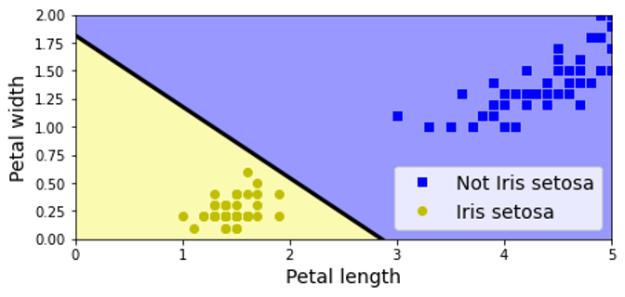
Perceptron Code (sklearn)
1
2
3
4
5
6
7
8
9
10
11
12
13
14
15
16
import numpy as np
from sklearn.datasets import load_iris
from sklearn.linear_model import Perceptron
def main():
iris = load_iris()
X = iris.data[:,(2,3)] # petal length, petal width
y = (iris.target == 0).astype(int) # iris setosa?
# Create model, train on data
model = Perceptron()
model.fit(X,y)
# Evaluate (i.e. predict)
y_pred = model.predict( [[2, 0.5]] )
print(y_pred)
if __name__ == "__main__":
main()
Heaviside step activation makes "hard" decision

Slide 7
Multilayer Perceptron
w₁₁ | w₁₂
w₂₁ | w₂₂
w₁₃ | w₂₃
w₁₄ | w₂₄
W¹ _{4x2}
=
g(.)
W² _{3x4}
a⁰₁
g(.)
g(.)
a⁰₂
g(.)
g(.)
a²
g(.)
g(.)
b¹
b²
a⁰
a¹ = g(W¹ a⁰ + b¹)
a² = g(W² a¹ + b²)
a^{L} = g(W^{L} a^{L-1} + b^{L})
Input Layer
Hidden Layer
Output Layer
Feed-forward neural network

Slide 8
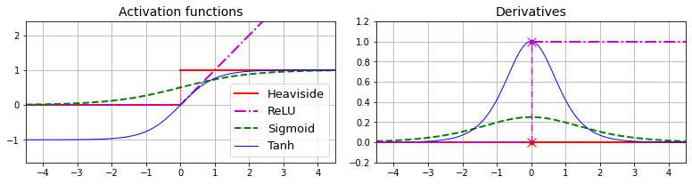
Activation Functions
Activation functions can allow non-linear boundaries
Ideally (easily) differentiable functions

Slide 9
Why do we need TF?
What about multiple units?
What about multiple layers?
What about different activation/loss functions?
How do we create more complex models?
Answer: Tensorflow (or Caffe, or PyTorch...)
"Deep learning frameworks"

Slide 10
What is TensorFlow (TF)?
Tensorflow is a deep learning framework
Numerical library based on Eigen, CUDA, NVidia cuDNN
CUDA provides access to GPU for fast linear algebra implementations
Specialised hardware orders of magnitude faster than software implementations
Mostly written in C++
But also, common layers, models, activation, loss functions...
But also, implementation of backpropagation to learn gradients
We have to use C++ to use Tensorflow?
No. You can but API's for many languages, Python, Java, Go, etc.

Slide 11
What is Keras?
Keras is an API to Deep Learning Framework(s)
Provides simplified access to Tensorflow
Used to support other DL frameworks: Theano, CNTK
Intended to make porting to different DL library easy
Makes model specification easier
PyTorch (sadly) is not supported as a backend
Keras is the default Python API to TF2
Keras is installed when you install TF

Slide 12
Tensorflow Architecture
Your Python Code
Keras (High-API)
language
APIs
Python (Low-API)
C++
Go
Java
...
Local/distributed Execution Engine
kernels
CPU
GPU
Android
iOS
...

Slide 13
Setup Environment: Requirements
##### Core scientific packages requirement.txt file contents
jupyterlab~=3.4.6
matplotlib~=3.5.3
numpy~=1.23.3
pandas~=1.4.4
scipy~=1.9.1
##### Machine Learning packages
scikit-learn~=1.1.2
# Optional: the transformers library is only used in chapter 16
transformers~=4.21.3
##### TensorFlow-related packages
# If you have a TF-compatible GPU and you want to enable GPU support, then
# replace tensorflow-serving-api with tensorflow-serving-api-gpu.
# Your GPU must have CUDA Compute Capability 3.5 or higher support, and
# you must install CUDA, cuDNN and more: see tensorflow.org for the detailed
# installation instructions.
tensorflow~=2.10.0
tensorboard~=2.10.0
tensorboard-plugin-profile~=2.8.0
tensorflow-datasets~=4.6.0
tensorflow-hub~=0.12.0
# Used in chapter 10 and 19 for hyperparameter tuning
keras-tuner~=1.1.3
# Optional: used in chapters 11 & 16 (for AdamW & seq2seq)
tensorflow-addons~=0.17.1
# Optional: statsmodels is only used in chapter 15 for time series analysis
statsmodels~=0.13.2

Slide 14
Setup Environment: Python venv
Can use whatever (virtual) environment you like
I will briefly describe Python venv setup
1
2
3
4
5
6
7
8
> mkdir dse-tf
> cd dse-tf
>
> python –m venv venv
> source activate ./venv/bin/activate
> pip install –r requirements.txt
>
> jupyter notebook

Slide 15
Setup Environment: conda
Can use whatever (virtual) environment you like
I will briefly describe conda setup
1
2
3
4
5
6
7
8
> mkdir dse-tf
> cd dse-tf
>
> conda create –n dse-tf python=3.10
> conda activate dse-tf
> pip install –r requirements.txt
>
> jupyter notebook

Slide 16
Tensorflow Common Template
1
2
3
4
5
6
7
8
9
10
11
import tensorflow as tf
from tensorflow import keras
from tensorflow.keras import layers
import numpy as np
def main():
# DATA
# MODEL (TRAIN)
# EVALUATE (TEST)
if __name__ == "__main__":
main()

Slide 17
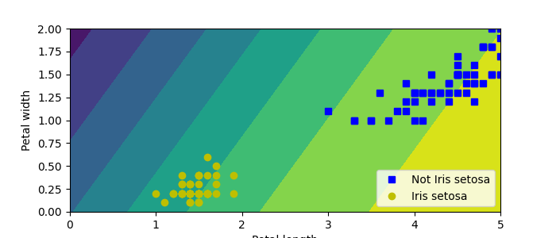
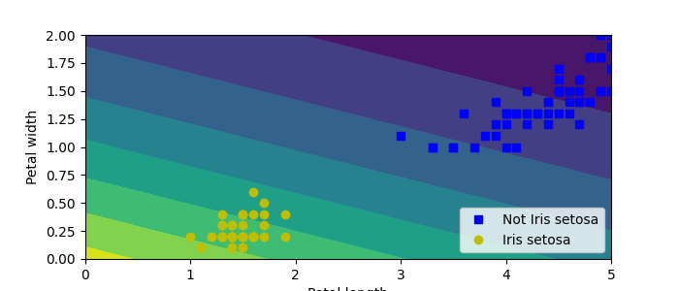
Perceptron Code (tensorflow)
1
2
3
4
5
6
7
8
9
10
11
12
13
14
15
16
17
18
19
from sklearn.datasets import load_iris
from tensorflow.keras.models import Sequential
from tensorflow.keras.layers import Dense
from tensorflow.keras.losses import BinaryCrossentropy
def main():
iris = load_iris()
X = iris.data[:,(2,3)] # petal length, petal width
y = (iris.target == 0).astype(int) # iris setosa?
# Create model, train on data
layer1 = Dense(units=1, activation="sigmoid")
model = Sequential( layer1 )
model.compile( optimizer="sgd", loss=BinaryCrossentropy() )
model.fit(X,y)
# Evaluate (i.e. predict)
y_pred_prob = model.predict( [[2, 0.5]] )
if __name__ == "__main__":
main()

Slide 18
Regression with Tensorflow
1
2
3
4
5
6
7
8
9
10
11
12
13
14
15
16
# Define the training data: input xs and answers ys
# dtype clue that TF is not python because most tf.types are c++, not python types
# The function (aka rule) to map x -> y, y = 2x - 1
xs = np.array( [-1.0, 0.0, 1.0, 2.0, 3.0, 4.0], dtype=float )
ys = np.array( [-3.0, -1.0, 1.0, 3.0, 5.0, 7.0], dtype=float )
# The input is one data value, model has one neuron, output is one value
# All models in TF must have an optimizer and a loss function
model = keras.Sequential( [keras.layers.Dense(units=1, input_shape=[1])] )
model.compile( optimizer="sgd", loss="mean_squared_error" )
# Learn the function that maps x to y
# Iterate enough times, more usually means better approximation too true function
model.fit( xs, ys, epochs=500 )
# Evaluate the model to see how well it learned the function
print( model.predict([10.0]) )

Slide 19
Data Sets
Randomly split into 2 or 3 sets
Typical percentage splits are 60/20/20 train/val/test
Test is proxy for how well model generalizes
data
X_train, X_test, y_train, y_test = train_test_split(X, y, test_size=0.20)
X_train, X_val, y_train, y_val = train_test_split(X_train, y_train, test_size=0.25)
Train
Validation
Test

Slide 20
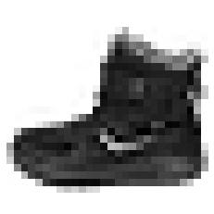
Image Classifier (not a CNN)
a⁰₁
g(.)
0.05 | "T-shirt/top"
0.05 | "Trouser"
0.05 | "Pullover"
0.05 | "Dress"
0.05 | "Coat"
0.10 | "Sandal"
0.05 | "Shirt"
0.25 | "Sneaker"
0.05 | "Bag"
0.30 | "Ankle boot"
g(.)
g(.)
a⁰₂
g(.)
...
...
...
...
g(.)
g(.) = softmax
g(.)
28 x 28
g(.)
1
a⁰
1
1
(28x28)
Input
((28x28), 784)
Flatten Layer
(784, 300)
Dense Layer
(300, 100)
Dense Layer
(100,10)
Dense Output
Feed-forward neural network

Slide 21
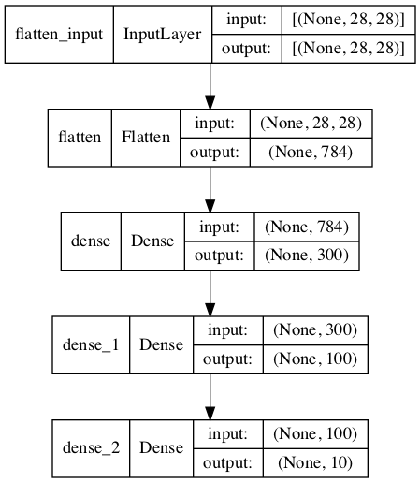
Image Classifier (not a CNN) TF
1
2
3
4
5
6
7
8
9
10
# Create model, train on the data
model = tf.keras.Sequential()
model.add(tf.keras.layers.InputLayer(input_shape=[28, 28]))
model.add(tf.keras.layers.Flatten())
model.add(tf.keras.layers.Dense(300, activation="relu"))
model.add(tf.keras.layers.Dense(100, activation="relu"))
model.add(tf.keras.layers.Dense(10, activation="softmax"))
model.compile(loss="sparse_categorical_crossentropy", optimizer="sgd", metrics=["accuracy"])
history = model.fit(X_train, y_train, epochs=10, validation_data=(X_valid, y_valid))
Layer (type) Output Shape Param #
=================================================================
flatten (Flatten) (None, 784) 0
dense (Dense) (None, 300) 235500
dense_1 (Dense) (None, 100) 30100
dense_2 (Dense) (None, 10) 1010
=================================================================
Total params: 266,610
Trainable params: 266,610
Non-trainable params: 0
# Hand estimation of the number of parameters
# Do not forget about the biases!
235500 = (784 * 300) + 300
30100 = (300 * 100) + 100
1010 = (100 * 10) + 10

Slide 22
Regression MLP
Sequential Model
Layers ordered as added
Output from previous layer is input to next layer
Layer (type) Output Shape Param #
=================================================================
normalization_1 (Normalize) (None, 8) 17
dense_9 (Dense) (None, 50) 450
dense_10 (Dense) (None, 50) 2550
dense_11 (Dense) (None, 50) 2550
dense_12 (Dense) (None, 1) 51
=================================================================
Total params: 5,618
Trainable params: 5,601
Non-trainable params: 17
(8)
Input
(8,8)
Normal
(8, 50)
Dense
(50, 50)
Dense
(50, 50)
Dense
(50, 1)
Output

Slide 23
Regression MLP Code
1
2
3
4
5
6
7
8
9
10
11
12
13
14
15
16
17
18
19
20
21
22
23
24
25
26
27
28
#=====================================================#
# Load data, load and split the California housing dataset, like earlier
#=====================================================#
housing = fetch_california_housing()
X_train_full, X_test, y_train_full, y_test = train_test_split(housing.data, housing.target, random_state=42)
X_train, X_valid, y_train, y_valid = train_test_split(X_train_full, y_train_full, random_state=42)
#=====================================================#
# Create model
#=====================================================#
norm_layer = tf.keras.layers.Normalization(input_shape=X_train.shape[1:])
model = tf.keras.Sequential([
norm_layer,
tf.keras.layers.Dense(50, activation="relu"),
tf.keras.layers.Dense(50, activation="relu"),
tf.keras.layers.Dense(50, activation="relu"),
tf.keras.layers.Dense(1)
])
model.compile(loss="mse", optimizer="adam", metrics=["RootMeanSquaredError"])
norm_layer.adapt(X_train)
history = model.fit(X_train, y_train, epochs=20, validation_data=(X_valid, y_valid))
#=====================================================#
# Evaluate, predict
#=====================================================#
mse_test, rmse_test = model.evaluate(X_test, y_test)
X_new = X_test[:3]
y_pred = model.predict(X_new)

Slide 24
Sequential and Functional Model
1
2
3
4
5
6
# Sequential Model
model = Sequential()
model.add(InputLayer(input_shape=a0_len))
model.add(Dense(30, activation="relu"))
model.add(Dense(30, activation="relu"))
model.add(Dense(1, activation="linear"))
equivalent, but...
1
2
3
4
5
6
7
8
9
10
11
12
13
14
# Functional Model
# First create layers
input_ = InputLayer(input_shape=a0_len)
hidden1_layer = Dense(30, activation="relu")
hidden2_layer = Dense(30, activation="relu")
output_layer = Dense(1 , activation="linear")
# Now connect layers
hidden1_out = hidden1_layer(input_)
hidden2_out = hidden2_layer(hidden1_out)
output = output_layer(hidden2_out)
model=Model(inputs=[input_],outputs=[output])
(8)
Input
(8, 8)
Normal
(8, 30)
Dense
(30, 30)
Dense
(30, 1)
Output

Slide 25
Wide and Deep Neural Network
Requires Functional Model (short vs deep path)
Layer (type) Output Shape Param # Connected to
===============================================================================
input_1 (InputLayer) [(None, 8)] 0 []
normalization (Normalization) (None, 8) 17 ['input_1[0][0]']
dense (Dense) (None, 30) 270 ['normalization[0][0]']
dense_1 (Dense) (None, 30) 930 ['dense[0][0]']
concatenate (Concatenate) (None, 38) 0 ['normalization[0][0]',
'dense_1[0][0]']
dense_2 (Dense) (None, 1) 39 ['concatenate[0][0]']
===============================================================================
Total params: 1,256
Trainable params: 1,239
Non-trainable params: 17
(8)
Input
(8,8)
Norm
(8, 30)
Dense
(30, 30)
Dense
( [8, 30], 38)
Concat
(39, 1)
Output

Slide 26
Wide and Deep Neural Network
1
2
3
4
5
6
7
8
9
10
11
12
13
14
15
16
1718
19
# Create layers
input_ = tf.keras.layers.Input(shape=X_train.shape[1:])
norm_layer = tf.keras.layers.Normalization()
hidden1_layer = tf.keras.layers.Dense(30, activation="relu")
hidden2_layer = tf.keras.layers.Dense(30, activation="relu")
concat_layer = tf.keras.layers.Concatenate()
output_layer = tf.keras.layers.Dense(1, activation="linear")
# Connect layers according to architecture
norm_output = norm_layer(input_)
hidden1_output = hidden1_layer(norm_output)
hidden2_output = hidden2_layer(hidden1_output)
concat_output = concat_layer([norm_output, hidden2_output])
output = output_layer(concat_output)
model = tf.keras.Model(inputs=[input_], outputs=[output])
# NB: Need to use Adam optimiser, SGD fails to find a solution!
model.compile(loss="mse", optimizer="adam", metrics=["RootMeanSquaredError"])
model.fit(X_train, y_train, epochs=10, validation_data=(X_valid, y_valid))

Slide 27
Training Loop
Each epoch try to adjust weights to reduce loss
Key question: How many epochs? More epochs is always better?
1
2
3
4
5
6
7
8
9
10
11
12
13
14
1516
# Outline of the model.fit function
def fit(X_train, y_train, epochs=10, batch_size=32, learning_rate=0.001)
for epoch in range(1, epochs+1):
# Process in batches, vectorized so larger batches means better performance
loss = 0.0
for step in (len(X_train)//batch_size):
# FORWARD PASS: get batch, predict, determine loss
X_batch, y_batch = random_batch(X_train, y_train)
y_pred = model(X_batch)
batch_loss = loss_fn(y_pred, y_batch)
loss += batch_loss
# BACKWARD PASS: determine which way to move weights to reduce loss
gradients = tape.gradient( batch_loss, model.weights )
# optimise, apply gradient to current weights
model.weights = model.weights + (learning_rate*gradients)
print(f"Epoch {epoch}/{epochs} loss={loss}")

Slide 28
Training Loop
Each epoch try to adjust weights to reduce loss
Run on training data, evaluate on validation/test data
Forward Pass
Backward Pass
W
b
W
b
W
b
W
b
W
b
Loss
W
b
Loss
(8)
Input
(8, 30)
Dense
(30, 30)
Dense
(30, 1)
Output
(8)
Input
(8, 30)
Dense
(30, 30)
Dense
(30, 1)
Output

Slide 29
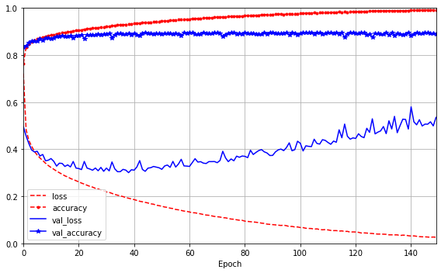
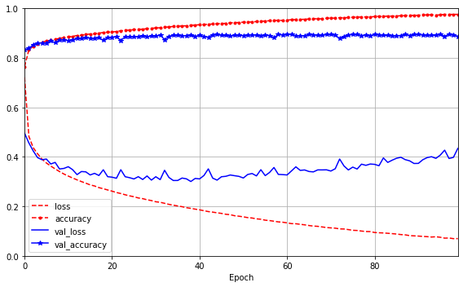
Training Loop - Overfitting
How to save best model based on validation acc?

Slide 30
Saving/Restoring Models
Need to save/restore models
1
2
3
4
5
6
7
8
9
10
11
#=====================================================#
# Save model
#=====================================================#
model = create_model()
model.save("my_keras_model", save_format="json")
#=====================================================#
# Sometime later, restore model
#=====================================================#
model = tf.keras.models.load_model("my_keras_model")
evaluate_model(model)
The fit function can take hours/days
How can we save at checkpoints during fit?
Use callbacks

Slide 31
Callbacks
ModelCheckpoint - saves best model on val set
EarlyStopping – stops training when no improvement on val set
1
2
3
4
5
6
7
8
9
10
11
checkpoint_cb = tf.keras.callbacks.ModelCheckpoint("my_model.h5", save_best_only=True)
early_stopping_cb = tf.keras.callbacks.EarlyStopping(patience=10, restore_best_weights=True)
# Must provide a validation set
history = model.fit(
(X_train_wide, X_train_deep), (y_train, y_train), epochs=200,
validation_data=((X_valid_wide, X_valid_deep), (y_valid, y_valid)),
callbacks=[checkpoint_cb, early_stopping_cb])
# Now load the model that did best on the validation set
model = tf.keras.models.load_model("my_model.h5")

Slide 32
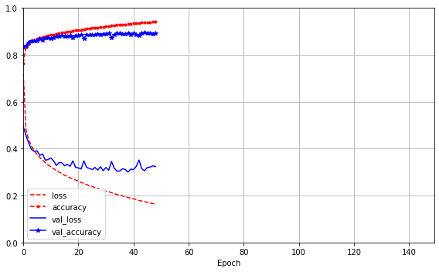
Callbacks – Early Stopping
Saves computation and helps mitigate overfitting
Will explore regularization (e.g. penalty term, dropout)

